Slide 1
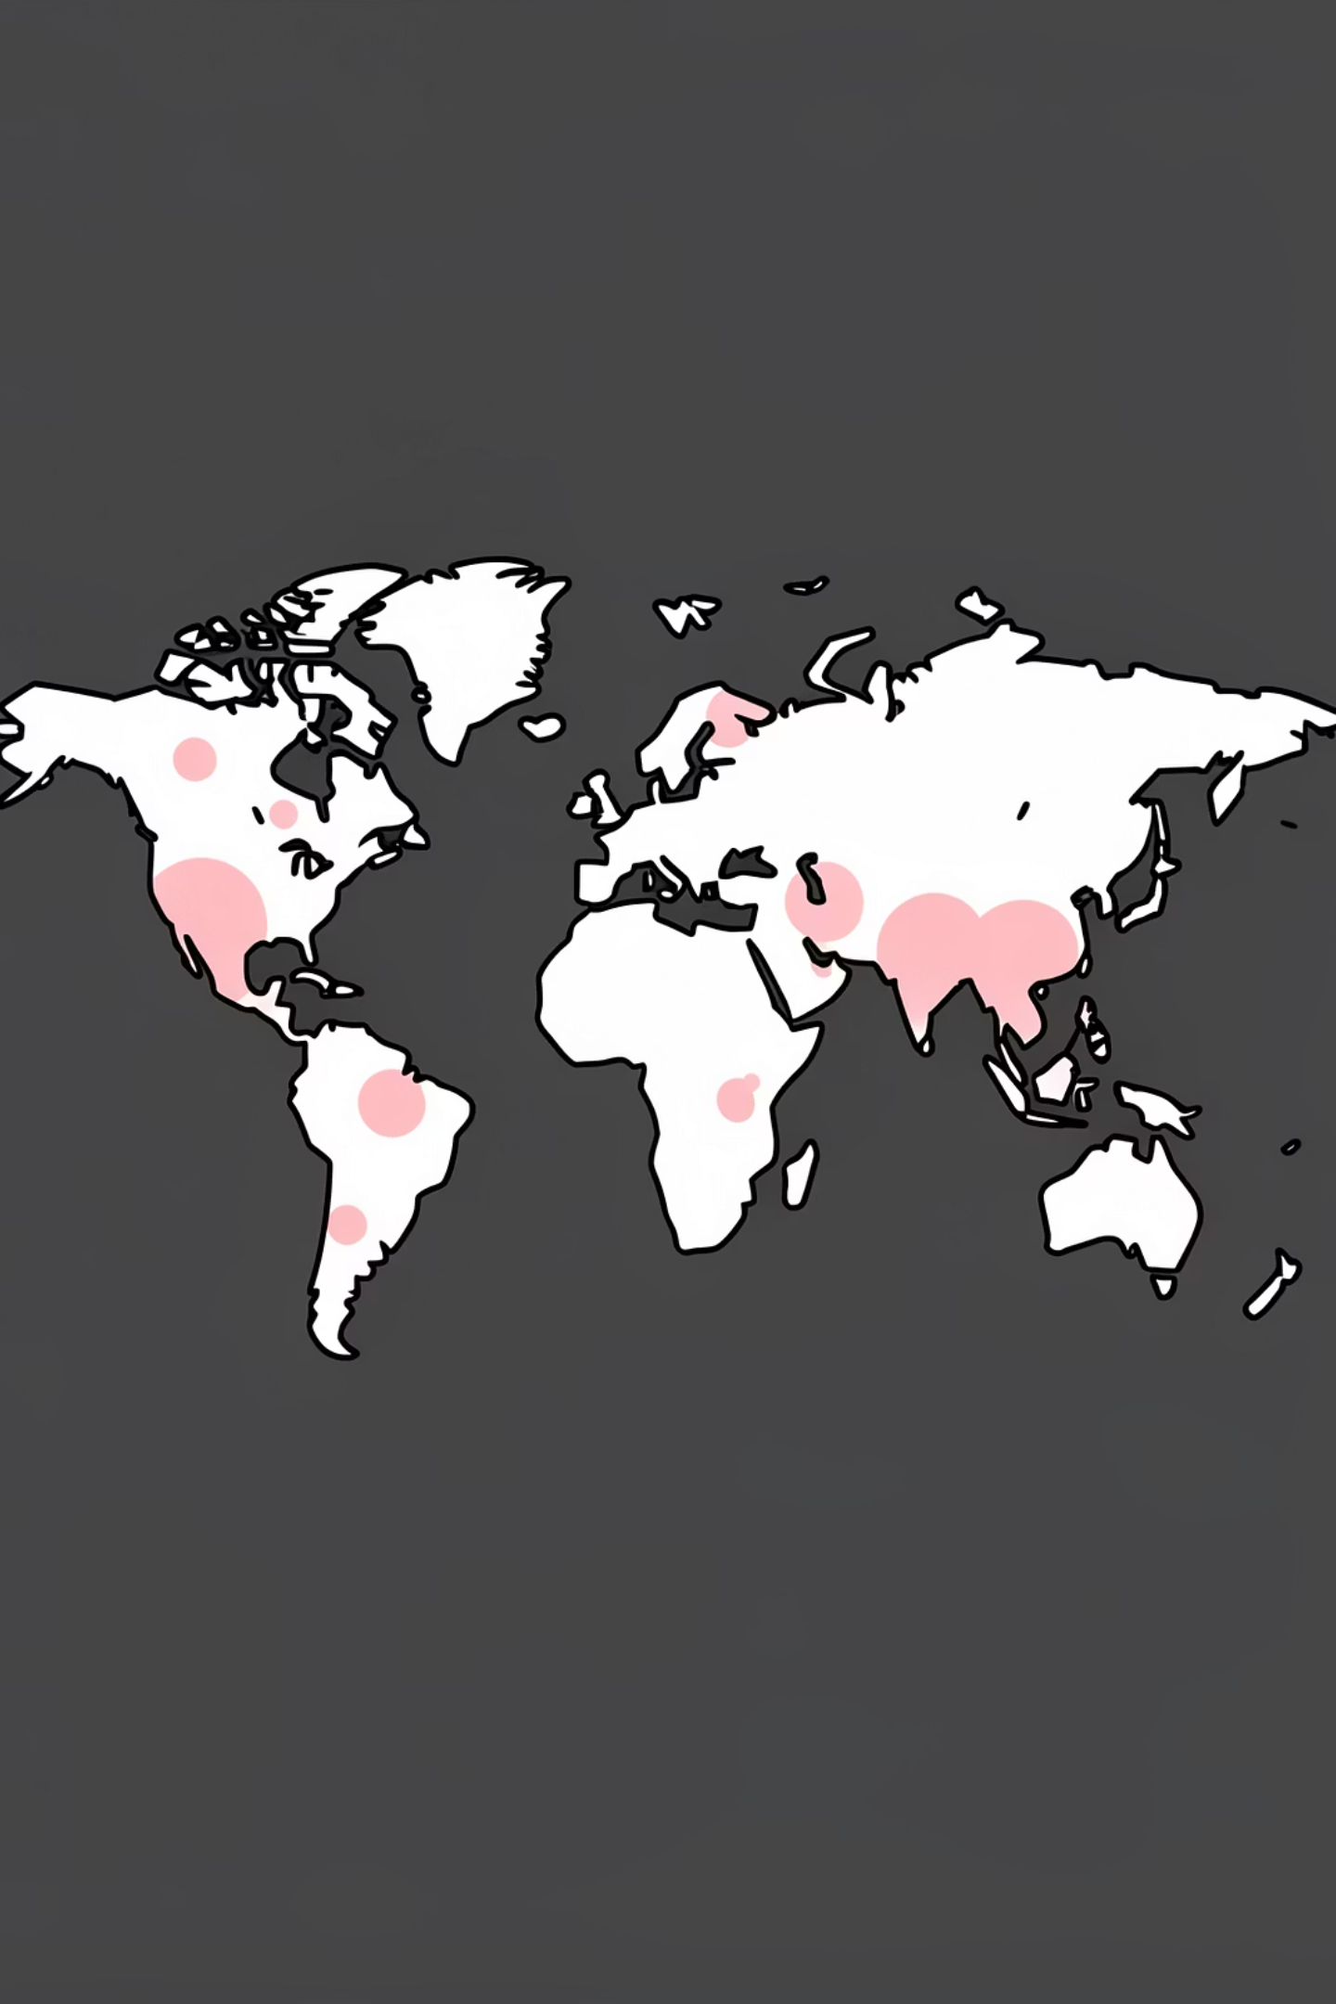
COVID-19 Data Analysis Project
SQL-based analysis of global pandemic data — cases, deaths, and vaccinations. Author: [Your Name]

Slide 2

Project Overview
Purpose
Focus Areas
Analyze COVID-19 impact across countries to evaluate healthcare responses and outcomes.
Death rates, infection rates vs population, vaccination progress, reusable SQL views/queries.

Slide 3

Datasets
Primary Tables
CovidDeaths — daily cases, deaths, population by location
CovidVaccinations — testing and vaccination data by location and date

Slide 4

Death Percentage Analysis
Calculated the likelihood of death after infection per country using total_deaths / total_cases * 100.
SELECT location, date, total_cases, total_deaths, (total_deaths/total_cases)*100 AS death_percentage FROM CovidDeaths WHERE location LIKE '%india%' ORDER BY 1,2

Slide 5
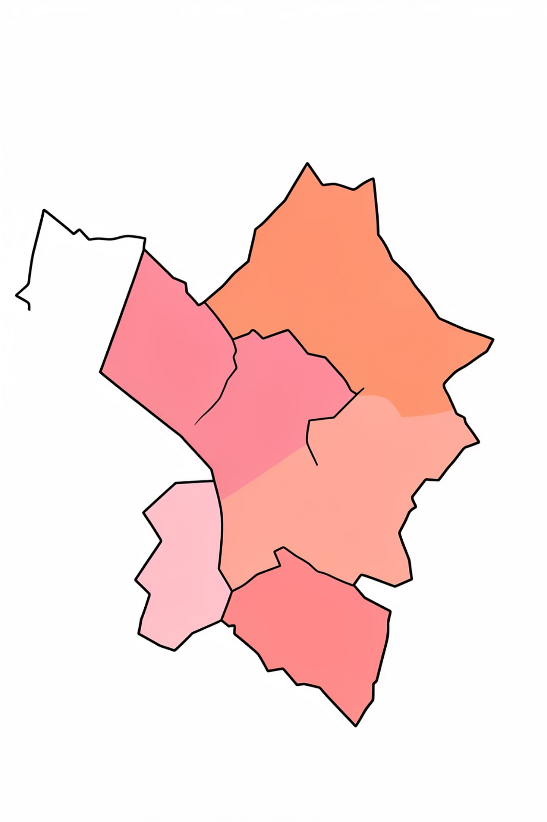
Infection Rate by Population
Identified countries with the highest percent of population infected using MAX(total_cases/population)*100.
SELECT location, population, MAX(total_cases) AS HighestInfectionCount, MAX((total_cases/population))*100 AS PercentPopulationInfected FROM CovidDeaths GROUP BY location, population ORDER BY PercentPopulationInfected DESC

Slide 6

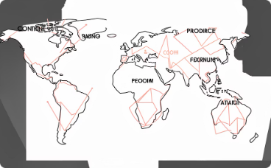
Highest Death Counts & Continental Breakdown
Countries with Highest Death Count
Continental Analysis
Aggregated max total_deaths per location to identify the most impacted countries.
Summed cases/deaths by continent and computed death percentage = total_deaths / total_cases * 100.
SELECT location, MAX(total_deaths) AS Total_Death_Count FROM CovidDeaths GROUP BY location ORDER BY Total_Death_Count DESC
SELECT continent, SUM(total_cases*1.0) AS total_cases, SUM(total_deaths*1.0) AS total_deaths, SUM(total_deaths*1.0)/SUM(total_cases*1.0)*100 AS death_percentage FROM CovidDeaths WHERE continent IS NOT NULL GROUP BY continent

Slide 7
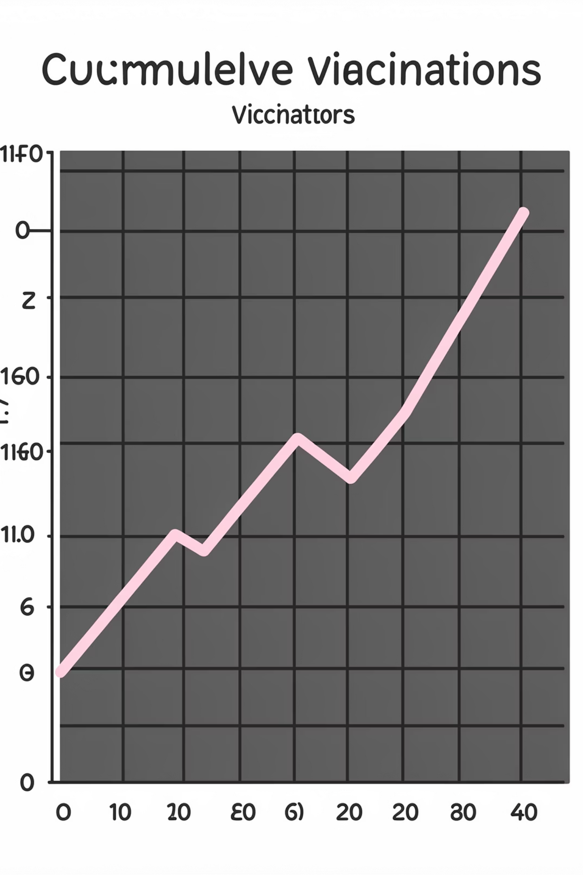
Vaccination Progress & Rolling Totals
Tracked rolling vaccination counts per location using window functions (PARTITION BY location ORDER BY date).
SELECT dea.continent, dea.location, dea.date, dea.population, vac.new_vaccinations, SUM(CONVERT(int,vac.new_vaccinations)) OVER (PARTITION BY dea.Location ORDER BY dea.location, dea.Date) AS RollingPeopleVaccinated FROM CovidDeaths dea JOIN CovidVaccinations vac ON dea.location = vac.location AND dea.date = vac.date WHERE dea.continent IS NOT NULL ORDER BY 2,3

Slide 8

Vaccination Percentage Approaches
Calculated vaccination percentage using CTEs, temp tables, and views for flexible reporting.
WITH PopvsVac (...) AS ( SELECT dea.continent, dea.location, dea.date, dea.population, vac.new_vaccinations, SUM(CONVERT(int,vac.new_vaccinations)) OVER (PARTITION BY dea.Location ORDER BY dea.location, dea.Date) AS RollingPeopleVaccinated FROM CovidDeaths dea JOIN CovidVaccinations vac ON dea.location = vac.location AND dea.date = vac.date WHERE dea.continent IS NOT NULL ) SELECT *, (RollingPeopleVaccinated/Population)*100 FROM PopvsVac

Slide 9

SQL Skills Demonstrated
Joins
Aggregates
Window Functions
CTEs & Views
Combining CovidDeaths and CovidVaccinations tables.
SUM, MAX, AVG with GROUP BY for summary metrics.
PARTITION BY for running totals (rolling vaccinations).
Readable queries and reusable views for reporting.

Slide 10

Challenges, Insights & Next Steps
Key Insights & Future Work
Death rates vary widely; infection% differs from raw counts
Vaccination rollout is uneven globally
Future: time-series waves, correlation of vaccinations vs deaths, age breakdowns, economic integration, automated reports
Challenges
Data type issues: numeric fields stored as text
NULL handling: missing continent values
Data quality & reporting inconsistency
Metric interpretation: careful definition of percentages

